Slide 1


Slide 2
INDUSTRIAL GRADE OMR SCANNER FOR EFFICIENT WORKFORCE AND PROCESS MANAGMENT
PRESENTED BY:
HUZAIFA SHAHBAZ[21-CE-009]
AQSA SHAH[21-CE-039]
PRESENTED TO:
SIR YASIR HAMID

Slide 3
OUTLINES
ABSTRACT
INTRODUCTION
OBJECTIVES
PROBLEM STATEMENT
PURPOSE OF THE PRODUCT
MARKET NEED AND INDUSTRIAL APPLICATIONS
PRODUCT DESIGN HARDWARE FEATURES
SOFTWARE FEATURES
FORM DESIGN COMPATIBILITY
TARGET USER AND BUSINESS SCOPE

Slide 4
OUTLINES
INDUSTRIES SERVED
BUSINESS BENFITS
PRODUCT DEVELOPMENT TIMELINE
COMPETITIVE ANALYSIS
PROJECT ESTIMATION
FINANCIAL PROJECTION
CHALLENGES AND RISK MITIGATION
CONCLUSION
REFERNCES

Slide 5
ABSTRACT
Industry 4.0 demands digital transformation for productivity
Gap exists in automating administrative work in manufacturing
Our solution Industrial-Grade OMR Scanner
Custom-designed for multinational manufacturing companies
Built for harsh shop-floor conditions with ERP integration
Reduces human error, expedites assessment, enhances compliance

Slide 6
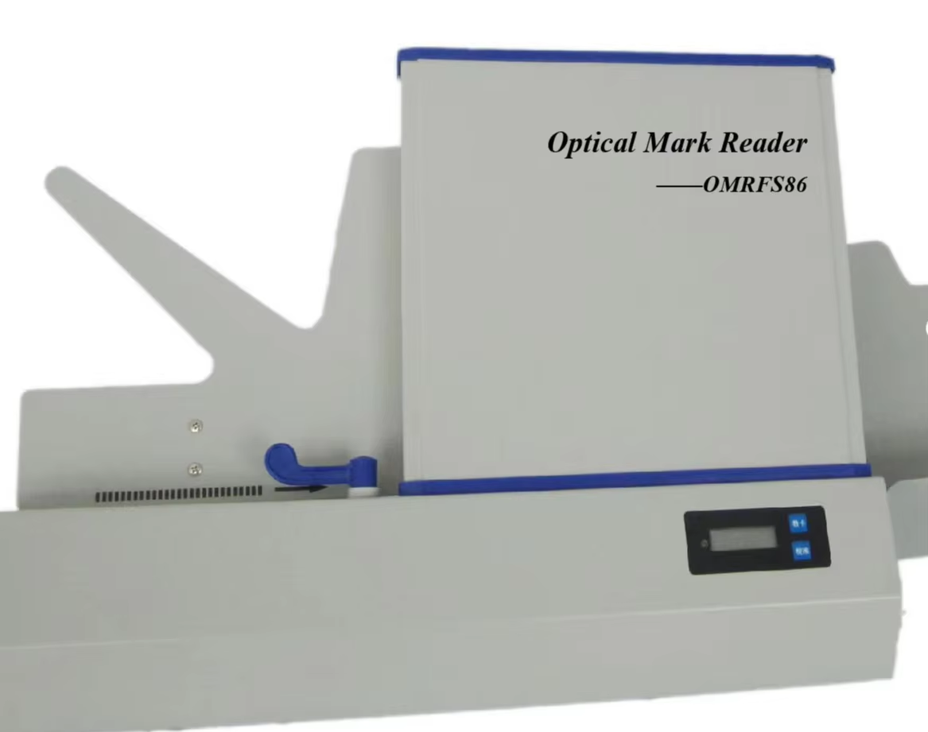
INTRODUCTION
THE CHALLENGES
Manufacturing environments prioritize digitization and automation
Administrative tools often lag in innovation
Traditional OMR scanners are designed for academic, not industrial use
OUR APPROACH
Reimagining OMR technology for manufacturing applications
Creating industrial-specific solutions for administrative efficiency
Addressing unique requirements of multinational companies

Slide 7
OBJECTIVES
Analyze OMR applications beyond academic settings
Identify operational gaps in employee management processes
Create rugged, industrial-grade prototype with enterprise features
Demonstrate advantages over generic OMR products
Evaluate economic and operational benefits for manufacturing

Slide 8
PROBLEM STATEMENT
Technology has revolutionized
Communication methods
Work environments (remote work, virtual collaboration)
Data management and analysis
The Gap Administrative processes in manufacturing remain manual, error-prone, and inefficient

Slide 9
PURPOSE OF THE PRODUCT
Our OMR Scanner aims to
Enhance speed and precision of employee evaluations
Streamline data collection for training and compliance
Replace error-prone manual data entry systems
Improve decision-making with fast analytics integration
Addressing the growing demand for data-backed personnel management in industrial environments

Slide 10
MARKET NEED AND INDUSTRIAL APPLICATIONS
PRIMARY USE CASES
Recruitment & Skill Testing Fast, accurate evaluation of candidates
Employee Training & Certifications Automated processing of mandatory assessments
Quality & Compliance Audits Standardized inspection checklists
Customer & Vendor Feedback Efficient data collection despite connectivity issues
Surveys & Internal Polling Swift data gathering without digital devices

Slide 11
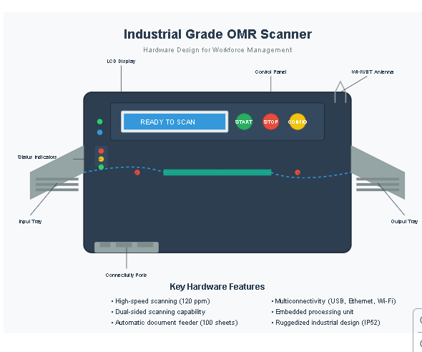
PRODUCT DESIGN HARDWARE FEATURES
High-speed scanning (up to 300 sheets/min)
Dual-side scanning with automatic page feed
Dustproof, factory-floor compliant casing (IP54 protection)
USB 3.0 and Ethernet connectivity
LED status indicators
Expandable paper tray (500 sheets)

Slide 12
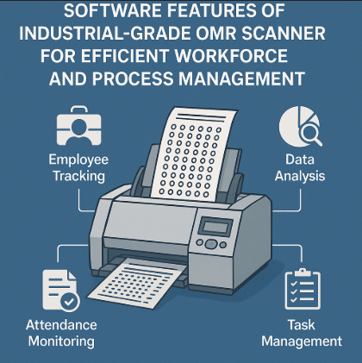
PRODUCT DESIGN SOFTWARE FEATURES
Smart alignment detection & auto-correction
OCR and barcode reader support
Batch processing mode
ERP integration APIs (SAP, Oracle)
Data export in PDF, XML formats
Multilingual interface with analytics dashboard

Slide 13
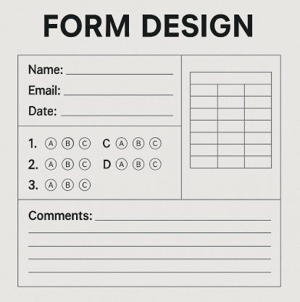
FORM DESIGN COMPATIBILITY
Our scanner works with customized forms including
Multiple choice tests
Feedback grids
Yes/No surveys
Scored audit checklists
All forms can be customized for specific industrial applications

Slide 14
TARGET USERS AND BUSINESS SCOPE
END USERS
HR departments
Safety and compliance officers
Floor managers and line supervisors
Quality auditors
Vendor management teams
Geographic Scope
SOUTH ASIA
SOUTHEAST ASIA
EUROPE
NORTH AND SOUTH AMERICA

Slide 15
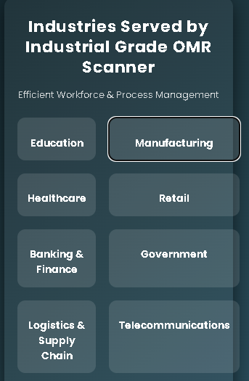
INDUSTRIES SERVED
Automotive manufacturing
Textiles production
Electronics assembly
Pharmaceutical production
Consumer goods manufacturing

Slide 16
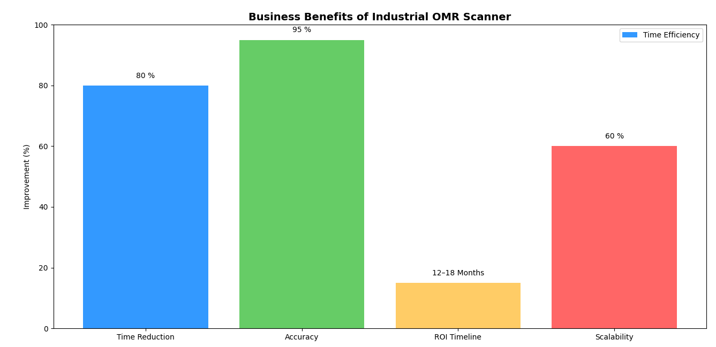
BUSINESS BENEFITS
Efficiency is 80% reduction in assessment processing time
Accuracy is 95% improvement in data reliability.
ROI is 12–18-month payback period
Scalability Enterprise-wide deployment capability

Slide 17
PRODUCT DEVELOPMENT TIMELINE
MONTH | MILESTONES
1 | Market Analysis & Requirement Survey
2 | Hardware Prototyping & Software Architecture
3 | Initial Testing & Debugging
4 | Beta Version Release & User Testing
5 | Final Product Design & Certifications
6 | Marketing, Documentation & Full Testing

Slide 18
COMPETITIVE ANALYSIS
FEATURE | OUR PRODUCT | GENERIC OMR
Dustproof Housing | YES | NO
ERP/API Integration | YES | LIMITED
Dual-Side Scan | YES | SOMETIMES
Factory Floor Use | DESIGNED FOR IT | NO
Multilingual Software | YES | RARE

Slide 19
PROJECT ESTIMATION
ITEM | COST | INTEREST RATE | TOTAL COST
R&D Prototyping | 14,000,000 PKR | 2,800,000 PKR | 16,800,000 PKR
Manufacturing Setup | 28,000,000 PKR | 5,600,000 PKR | 33,600,000 PKR
Marketing & Distribution | 8,400,000 PKR | 1,680,000 PKR | 10,080,000 PKR
TOTAL | 50,400,000 PKR | 10,080,000 PKR | 60,480,000 PKR

Slide 20
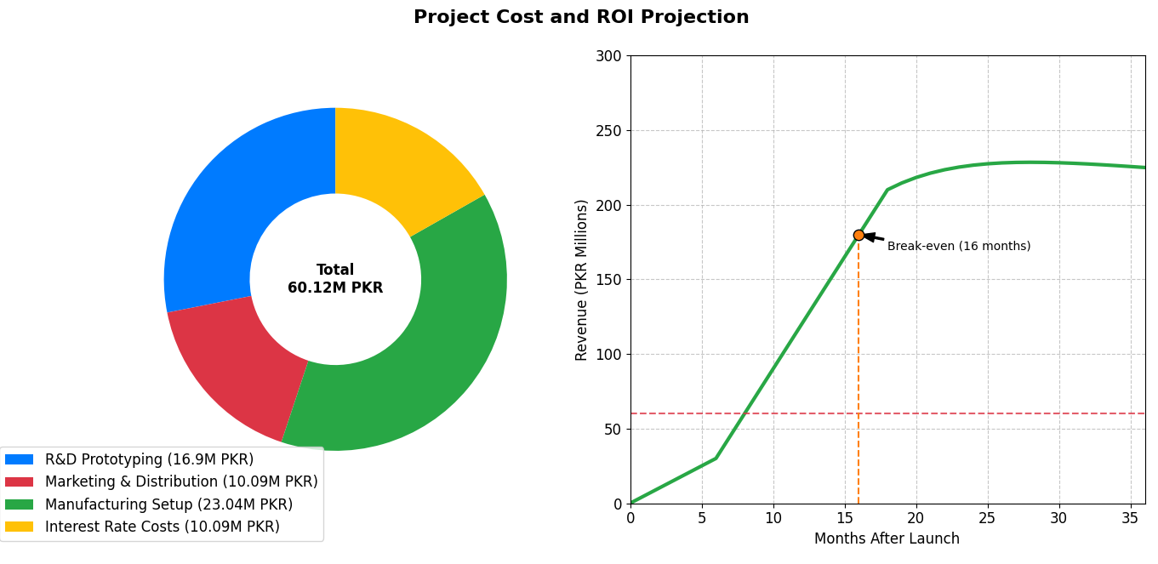
FINANCIAL PROJECTION
Estimated ROI Timeline is 12-18 months after full deployment.

Slide 21
CHALLENGES AND RISK MITIGATION
CHALLENGES | RISK MITIGATION
Adoption Resistance | Pilot rollout with HR and Quality departments
Language/Localization Issues | Multilingual templates and UI
Compatibility with Existing Systems | Develop open API and modular SDK
Environmental Durability | IP-rated housing and industrial testing

Slide 22
CONCLUSION
Industrial-grade OMR scanner offers cost-effective solution for manufacturing
Addresses administrative and compliance functions efficiently
Integrates with existing digital systems
Strategically advantageous in hybrid industrial ecosystem
6-month development timeline to market
Significant ROI potential for manufacturing enterprises

Slide 23
REFERENCES
Ahuja, V., & Thakur, N. (2020). OMR and its Application in Smart Industries. International Journal of Engineering Research & Technology, 9(3), 12–18.
Sharma, K. (2021). Digital Transformation in Manufacturing Industries: Role of Automation Tools. Manufacturing Today.
SAP SE. (2022). ERP Integration for Industrial Devices. Retrieved from https://www.sap.com
IDC Manufacturing Insights. (2023). Automation Trends in Asia-Pacific Manufacturing.
ISO 9001:2015. Quality Management Systems – Requirements. International Organization for Standardization.

Slide 24


Slide 25
